Slide 1
An industry can be defined as a group of companies offering products or services that are close substitute for each other-that is, products or services that satisfy the same basic customer needs.

Slide 2
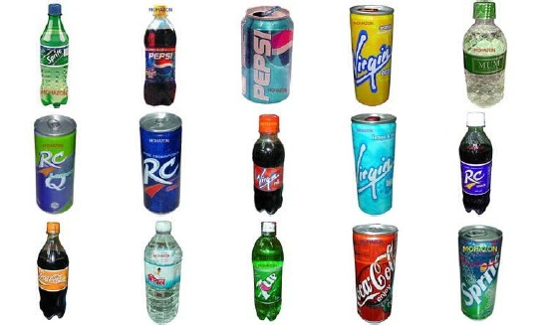
Beverage industry in Bangladesh

Slide 3
  A fragmented industry consists of a large number of small or medium sized companies, none of which is in a position to determine industry price. Examples-
      Dry cleaning, Video rental, health club, real estate brokerage and sun tanning parlors.

Slide 4
  A consolidated industry is dominated by a small number of large companies (an oligopoly) or in extreme case, by just one company (a monopoly), and companies often are in a position to determine industry prices.
  Examples-
  Aerospace,
  Soft drink,
  Automobile,
  Pharmaceuticals, Telecommunication.

Slide 5
Strategic Groups within industries
Pharmaceuticals industry
Proprietary group
Merck
Pfizer
Eli Lilly
Generic group
Forest labs
Mylan labs
Watson
Based on Heavy R & D spending
2. A focus on developing new products
Low-cost
copies of drugs

Slide 6
Industry life cycle analysis
Stages in the industry life cycle
embryonic
Growth
Shakeout
Maturity
Decline
    Embryonic stage
    Growth stage
    Shakeout stage
    Maturity stage
    Decline stage

Slide 7
Industry life cycle analysis
  Embryonic stage
  Features:
    Growth at this stage is slow because buyer’s unfamiliarity of products.
    High price due to the inability of companies to reap any significant scale economies.
    Poor developed distribution channel.
    Rivalry in embryonic industries is based not so much on-
        Price
        Opening up distribution channel
        Perfecting the design of the product.

Slide 8
Industry life cycle analysis
Growth industries
Once demand for the industry’s product begins to take off, the industry develops the characteristics of a growth industry.
  Features:
1. Demand is expanding rapidly as many new customers enter the market.
2. Prices fall because experience and scale economies have been attained.
3. Distribution channel developed.
4. Threats from potential competitors generally is highest at this point.
5. Rivalry tends to be relatively low.

Slide 9
Industry life cycle analysis
Shakeout industry
Exclusive growth can not be maintained indefinitely. Sooner or later, the rate of growth slows, and the industry enters the shakeout stage.
Features:
1. Demand approaches saturation levels.
2. Rivalry between companies become intense.
3. Demand is no longer growing at historic rates.
4. The consequences is the emergence of excess productive capacity.
5. There may a price war, which drives many of the most inefficient companies into bankruptcy, which is enough to deter any new entry.

Slide 10
Industry life cycle
Maturity industry
The shakeout stage ends when the industry enter its mature stage.
Features
1. The market is totally saturated.
2. Demand is limited to replacement demand.
3. Growth is low or zero.
4. Barrier to entry increase and the threat of entry
from potential competitors decrease.
5. Competition from market share develops.
6. Driving down prices often the result is price war.

Slide 11
Industry life cycle
Declining industry
Growth becomes negative for a variety of reasons including-
      Technological substitution.
      Social change.
  Degree of rivalry among established companies usually increases.
  Falling demand tends to the emergence of excess capacity.

Slide 12
  Companies try to cut price, thus sparking a price war.
  Exit barriers play a part in adjusting excess capacity. The greater the exit barriers, the harder it is for companies to reduce capacity and the greater is the threat of severe price competition.

Slide 13
  A patent is a grant of a property right by the government to an inventor. Anything that is patentable must be new and useful. It can be sold, transferred, willed, licensed.
  What can be patented-
    Process-methods of production, research, testing, analysis and other technologies with new applications.
    Machines-products, instruments, machines, and other physical objects that have proved useful and unique.
    Manufactures-combination of physical matter not found in nature fabricated in unique and useful applications.
    Composition of matters-chemical compounds, medicines, botanical compositions that do not exist in nature in an uncultivated state, nor those that could evolve in nature that are new and useful.

Slide 14
According to patent law, only an inventor may apply for a patent, but this rule has several refinements.
If an inventor dies before making an application, the executor or legal administrator of the estate can file for a patent on behalf of the deceased to protect the interest of heirs.
If a person is insane or incapable, a guardian may file for the inventor.
When two or more persons have a joint interest, the patent must be filed in all names of parties as joint inventors.
Anyone filing for a patent must swear by oath or make declaration that he or she has a proprietary interest in the invention.
In addition, anyone filing for a patent who is not the inventor is subject to criminal penalties.

Slide 15
Trade marks
A trademark includes any word, name, symbol, or distinguishing device or any combination thereof adopted and used by a manufacturer or merchant to identify his goods and distinguish them from those manufactured or sold by others.
Copyrights
A copy right is distinct from patents and trademark in that intellectual property is protected for the life of the originator plus 50 years.

Slide 16
A copy right extends protection to authors, composers, and artists and relates to the form of expression rather than the subject matter.
Visual matters under copy right protection are-
Photographs, painting, sculptures, poems, articles, stories, books, music, sound recordings, motion pictures, audio visual works, periodicals, computer punch cards, microfilm, choreographic works.

